Slide 1
Correlation Function
LEE, SungBin

Slide 2
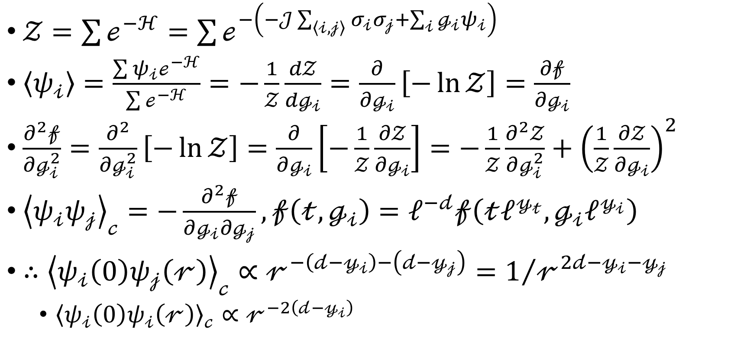
Correlation Function
$𝒵=\sum{ℯ^{−ℋ}}=\sum{ℯ^{−\left(−𝒥\sum_{\left\langle 𝒾,𝒿\right\rangle }{σ_{𝒾}σ_{𝒿}}+\sum_{𝒾}{ℊ_{𝒾}ψ_{𝒾}}\right)}}$
$\left\langle ψ_{𝒾}\right\rangle =\frac{\sum{ψ_{𝒾}ℯ^{−ℋ}}}{\sum{ℯ^{−ℋ}}}=−\frac{1}{𝒵}\frac{d𝒵}{dℊ_{𝒾}}=\frac{∂}{∂ℊ_{𝒾}}\left[−\ln{𝒵}\right]=\frac{∂𝒻}{∂ℊ_{𝒾}}$
$\frac{∂^{2}𝒻}{∂ℊ_{𝒾}^{2}}=\frac{∂^{2}}{∂ℊ_{𝒾}^{2}}\left[−\ln{𝒵}\right]=\frac{∂}{∂ℊ_{𝒾}}\left[−\frac{1}{𝒵}\frac{∂𝒵}{∂ℊ_{𝒾}}\right]=−\frac{1}{𝒵}\frac{∂^{2}𝒵}{∂ℊ_{𝒾}^{2}}+{\left(\frac{1}{𝒵}\frac{∂𝒵}{∂ℊ_{𝒾}}\right)}^{2}$
${\left\langle ψ_{𝒾}ψ_{𝒿}\right\rangle }_{𝒸}=−\frac{∂^{2}𝒻}{∂ℊ_{𝒾}∂ℊ_{𝒿}}, 𝒻\left(𝓉,ℊ_{𝒾}\right)=ℓ^{−𝒹}𝒻\left(𝓉ℓ^{𝓎_{𝓉}}, ℊ_{𝒾}ℓ^{𝓎_{𝒾}}\right)$
$∴{\left\langle ψ_{𝒾}\left(0\right)ψ_{𝒿}\left(𝓇\right)\right\rangle }_{𝒸}∝𝓇^{−\left(𝒹−𝓎_{𝒾}\right)−\left(𝒹−𝓎_{𝒿}\right)}=1/{𝓇^{2𝒹−𝓎_{𝒾}−𝓎_{𝒿}}}$
${\left\langle ψ_{𝒾}\left(0\right)ψ_{𝒾}\left(𝓇\right)\right\rangle }_{𝒸}∝𝓇^{−2\left(𝒹−𝓎_{𝒾}\right)}$

